Slide 1
Sparsity Oriented Importance Learning for High-dimensional Linear Regression
MAT4376 Presentation
Prof. Chen Xu
By:
Jiahui Dong & Qingyang Fu

Slide 2
INTRO
Variable importance measure has been an interesting research topic that helps to identify which variables are most important for understanding, interpretation, estimation or prediction purposes.
In this paper, we propose a new variable importance measure, sparsity oriented importance learning (SOIL), for high-dimensional regression from a sparse linear modeling perspective by taking into account the variable selection uncertainty via the use of a sensible model weighting.

Slide 3

OUTLINE
What:
What scientific problem is addressed in the paper?
What is the corresponding mathematical or statistical problem?
Why:
Why is this problem important?
Why is this problem challenging?
Why existing methods can not solve this problem?
How:
How do the authors tackle this problem?
How do they justify the proposed method?

Slide 4
In high-dimensional regression, how to improve reliability and reproducibility in model choice.
What scientific problem is addressed in the paper?

Slide 5
What is the
corresponding mathematical
or statistical problem?
How to make good use of a variable importance measure to select variables.

Slide 6
Why is this problem important?
Data analysts is unsatisfied with single final model.
Reduce the list of variables with importance values below a thresholds.
Offering a ranking of variables
Saving time and cost in data analysis.
Helping decision makers to understand the underlying data process than trust any single model, and to gain ability to change or replace variables.

Slide 7
Why is this problem challenging?
Variable importance depends on the goal of the analysis and application.
based on parametric model or nonparametric model.
Should the importance measure be purely relative to compare different variables or should their values have some meaning on their own.

Slide 8
Why existing methods can not solve this problem?
3 existing method：
Simple measure based on final model;
LMG:R^2 decomposition;
Random Forest
Simple measure based on Final model: “Winner takes all”; Variable selection uncertainty ignored; Non-selected variable have zero importance.
LMG(R^2 decomposition): Only deal up to 20 variables
Random Forest: some noise variables receive relatively large importance values, even higher than almost half of the true variables.

Slide 9
How do the authors tackle this problem?
New variable importance measure: Sparsity Oriented Importance measure (SOIL).
SOIL:
Two ingredients: a manageable set of models and a reliable weighting method on the models.
Measure of importance of the predictors in an absolute scale in [0,1].

Slide 10
SOIL: Sparsity Oriented Importance Learning
Features/advantages:
Involves multiple high-dimensional variable selection methods and combines all the solution path models.
Uses external weighting(independent of the model selection methods) to avoid bias.
When the weighting is sensible, the importance of the variables will tend to 0 or 1 as the sample size grows.
Has excellent performance in the numerical study with satisfying behaviors including exclusion, inclusion, order preserving, robustness, etc.

Slide 11
Use of Informative Importance Measures Can Improve the Reliability of Data Analysis in Many Ways:
More objective: immediately inspect if "true" variables are missing in the set or unimportant variables are involved.
Finding best model: the most suitable variables for sparse modeling receive higher importance values.
Getting a sense on model selection uncertainty: data analyst will be informed on possible alternative models/covariates.
Helping on the choice between model selection and model averaging.

Slide 12
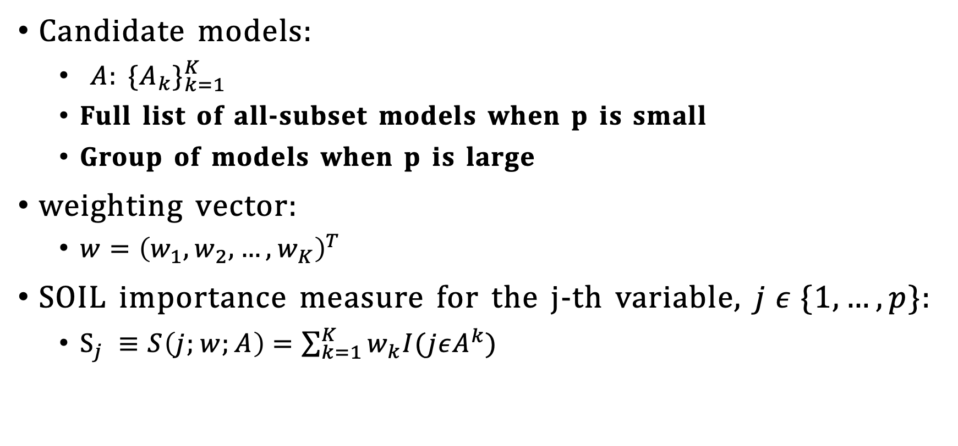
SOIL: General Methodology
Candidate models:
$A$: ${{\{A}_{k}\}}_{k=1}^{K}$
Full list of all-subset models when p is small
Group of models when p is large
weighting vector:
$w={\left(w_{1},w_{2},…,w_{K}\right)}^{T}$
SOIL importance measure for the j-th variable, $j ε \{1,…,p\}$:
$S_{j} ≡S\left(j;w;A\right)=\sum_{k=1}^{K}{w_{k}I(jεA^{k})}$

Slide 13
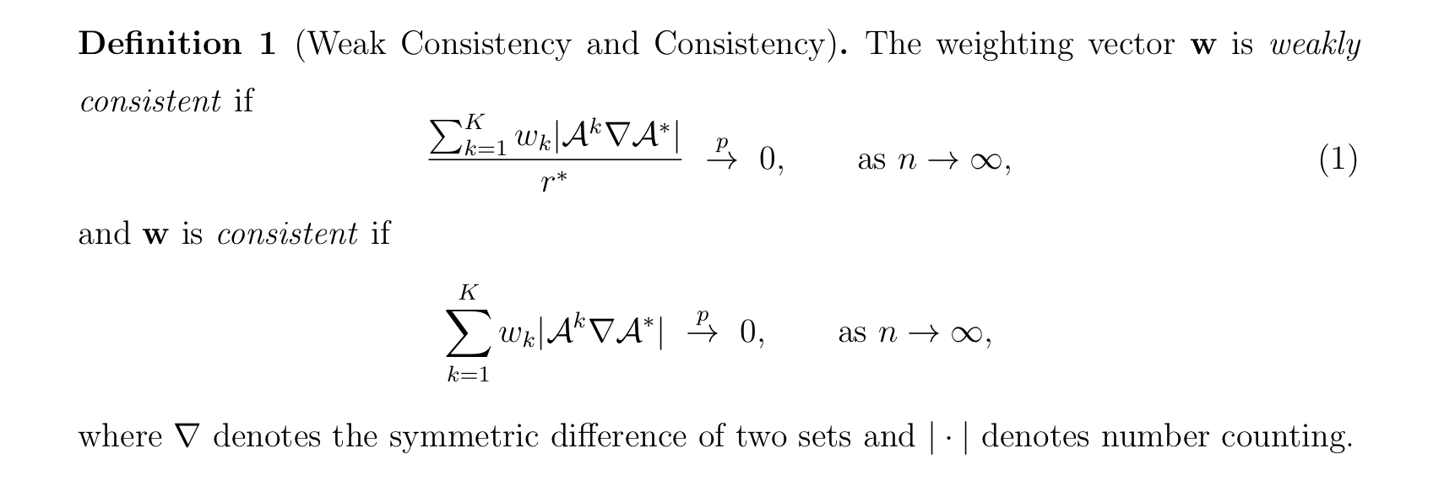
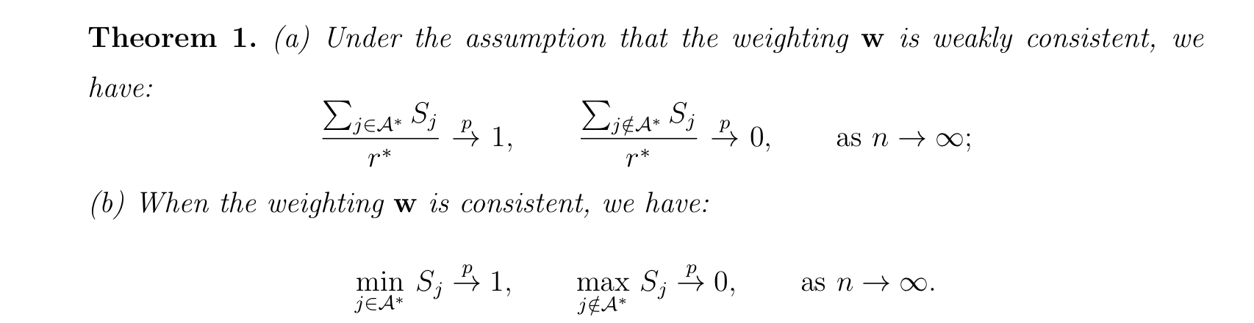
SOIL: Theoretical properties
Consistency of the SOIL
Weak consistency
Consistency
Ensure the weighting is concentrated enough around the true model.

Slide 14
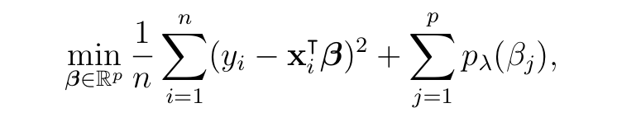
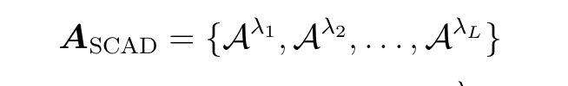
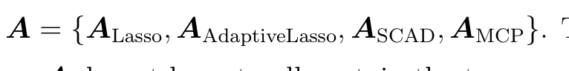
Candidate models
In the high-dimensional setting (p>>n), it is computationally infeasible to use the candidate models with all subsets.
Using tools for high-dimensional penalized regression
Penalty functions: Lasso, SCAD, MCP
Apply a method to compute solution paths, e.g. SCAD
Put together the models to form a larger set of candidate models

Slide 15
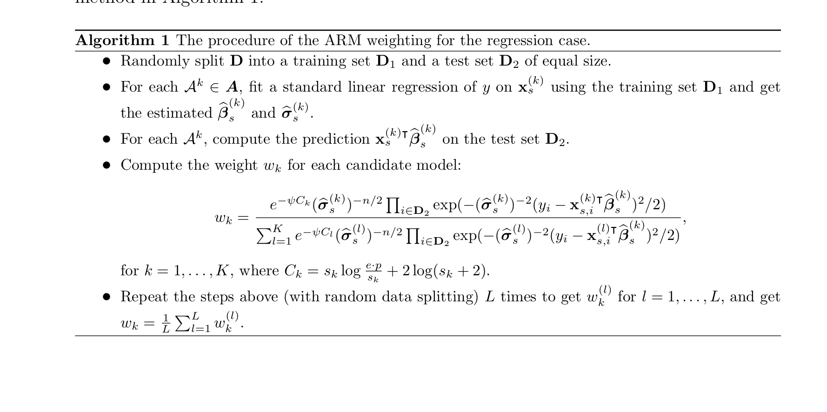
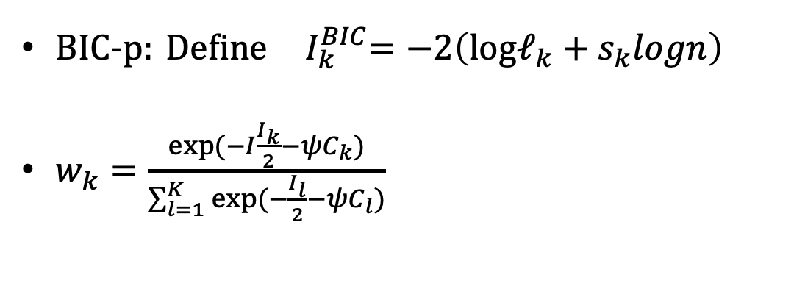
Weighting
Two weighting methods:
ARM weighting
BIC-p weighting.
Need to consider the model complexity
Prior probability for the model
Non-uniform prior
BIC-p:${ \text{Define} I}_{k}^{BIC}=−2\left(logℓ_{k}+s_{k}logn\right)$
$w_{k}=\frac{exp⁡(−I\frac{I_{k}}{2}−ψC_{k})}{\sum_{l=1}^{K}{exp⁡(−\frac{I_{l}}{2}}−ψC_{l})}$

Slide 16
How do they justify the proposed method?
By comparing SOIL( BIC-p) and SOIL(ARM) with RFI1, RFI2, LMG.
LMG: relative importance measure by averaging over all possible orderings for R^2 decomposition.
RFI1: computed from a normalized difference between the prediction error on OOB portion of the data and that on the permuted OOB data for each predictor variable.
RFI2: the total decrease in node impurities from splitting on a particular variable, averaged over all trees.

Slide 17
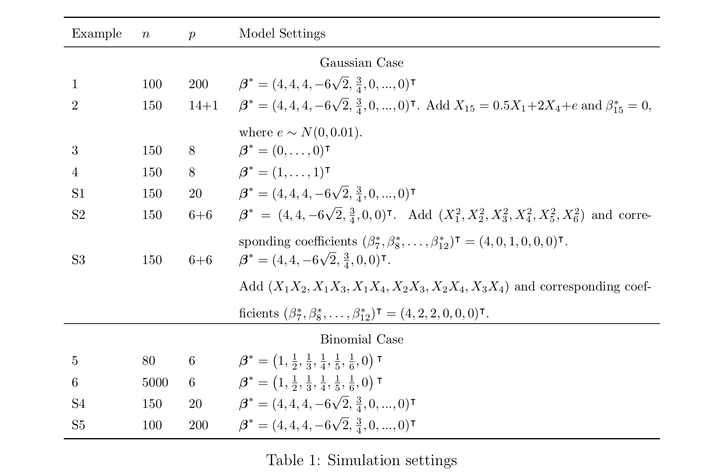
Relative Performances of Importance Measures

Slide 18
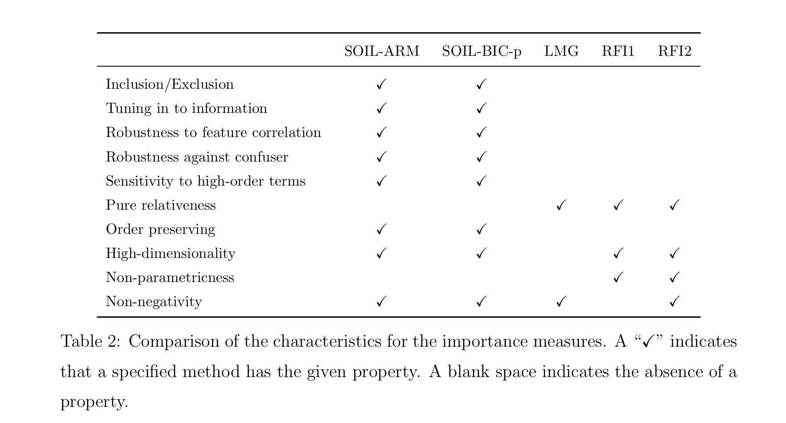
Relative Performances of Importance Measures

Slide 19
Relative performances of importance measures
Inclusion/exclusion: address the issue if an importance measure can give a proper sense if a predictor is likely to be needed in the best model to describe the data.
SOIL-BIC-p and SOIL-ARM have inclusion/exclusion properties in all the examples.
Tuning in to information: the importance obtained should change due to the enrichment of information.
Only SOIL-BIC-p and SOIL-ARM react to the much-increased info due to sample size increases.
Robustness to feature correlation: SOIL importance show robustness against noise increase and higher feature correlation.
Robustness against confusers: an importance measure oriented towards sparse modeling should assign near zero importance on the confusers.
SOIL importance measures are much more robust to confusers.

Slide 20
Relative performances of importance measures
Sensitivity to higher-order terms: SOIL importance measures are more sensitive to inclusion of higher-order terms in the model.
Order preserving: refers to the property that the importance reflects the "order" of the variables or not.
SOIL importance measures exhibit the order preserving property in all the cases.
High-dimensionality: LMG does not support high-dimensional data
Non-negativity: RFI1 does not yield non-negative importance value.

Slide 21
Real Data Example
Two type of dataset:
BGS(Berkeley Guidance Study) with small p
Bardet data with large p
SOIL-ARM and SOIL-BIC-p perform reasonably better than the other importance measure.
SOIL certainly can miss subtle variables in the true model when the sample size is small. But it does not recommend an unimportant variable as important.

Slide 22
Conclusion
In summary, the SOIL method is helpful in different stages of model building. It can be used to narrow down the set of covariates for further consideration and for reaching a final model with sound considerations.
More importantly, it provides an objective view on reliability of the model and the model selection uncertainty.
Therefore, it can help much improve reproducibility of data analysis that involves variable selection.

Slide 23
谢谢 MERCI THANK YOU

